Slide 1

E6895 Advanced Big Data Analytics Task Milestone 2:
Visual Exploration of Large Graph in Immersive Environment
Sam Guleff [SG2665]
February 2nd, 2017

Slide 2

Milestone Goals
Milestone I – Research, Setup & Design
Milestone II – Build Fundamentals and Demo
Milestone III – Advance & Extend Capabilities
Aspirational – External Connections & Advanced Interactions

Slide 3
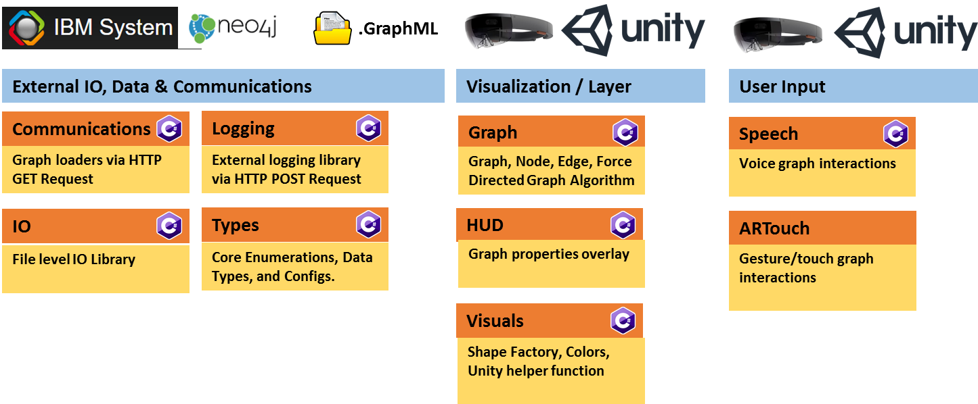
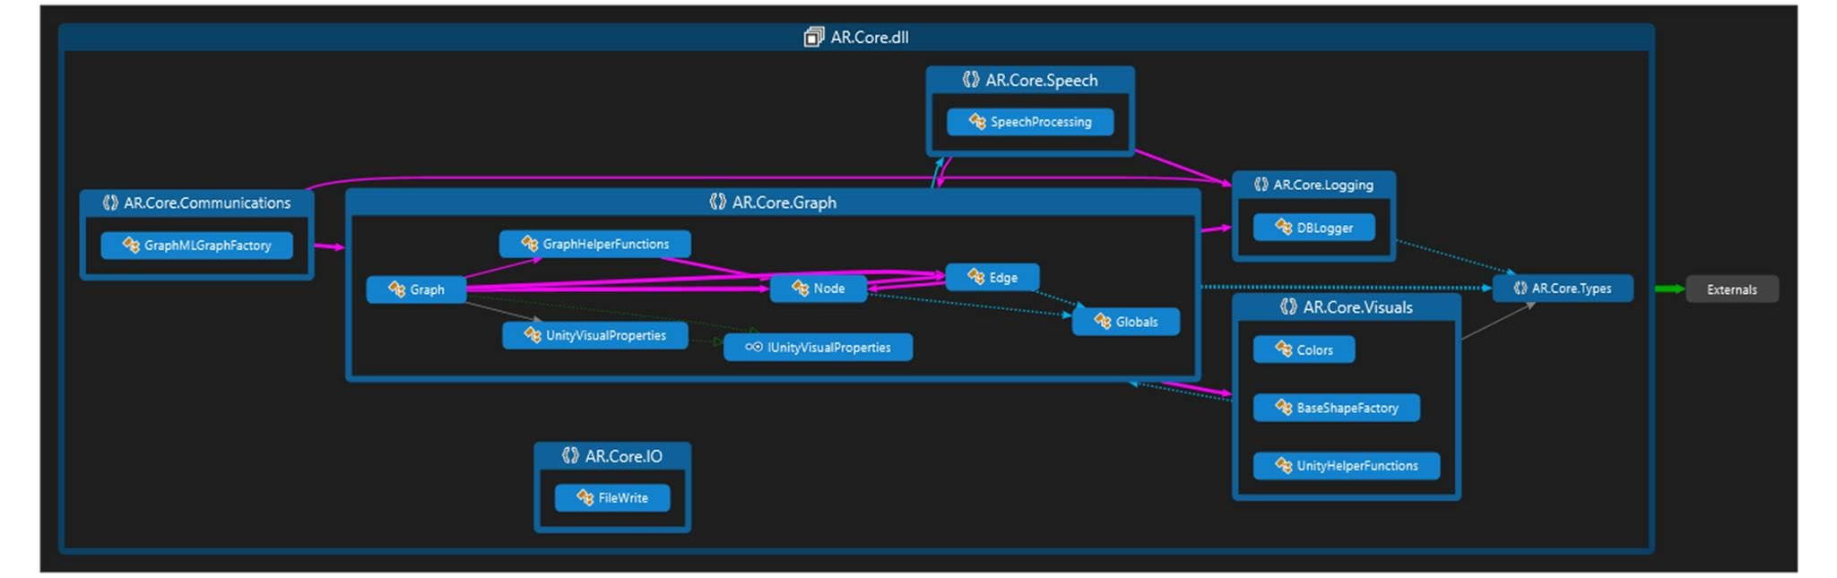
Milestone II – Current Library Architecture

Slide 4
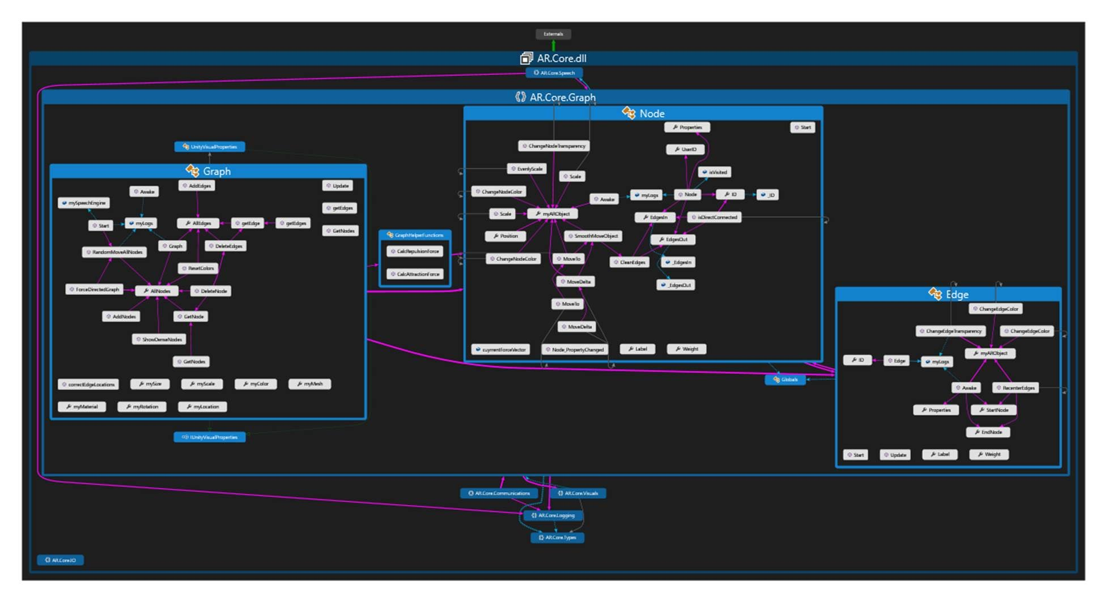
Milestone II – Current Library Architecture (Dependencies)

Slide 5
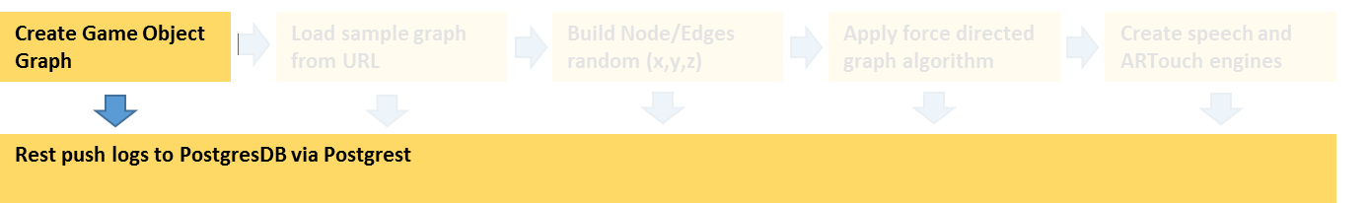
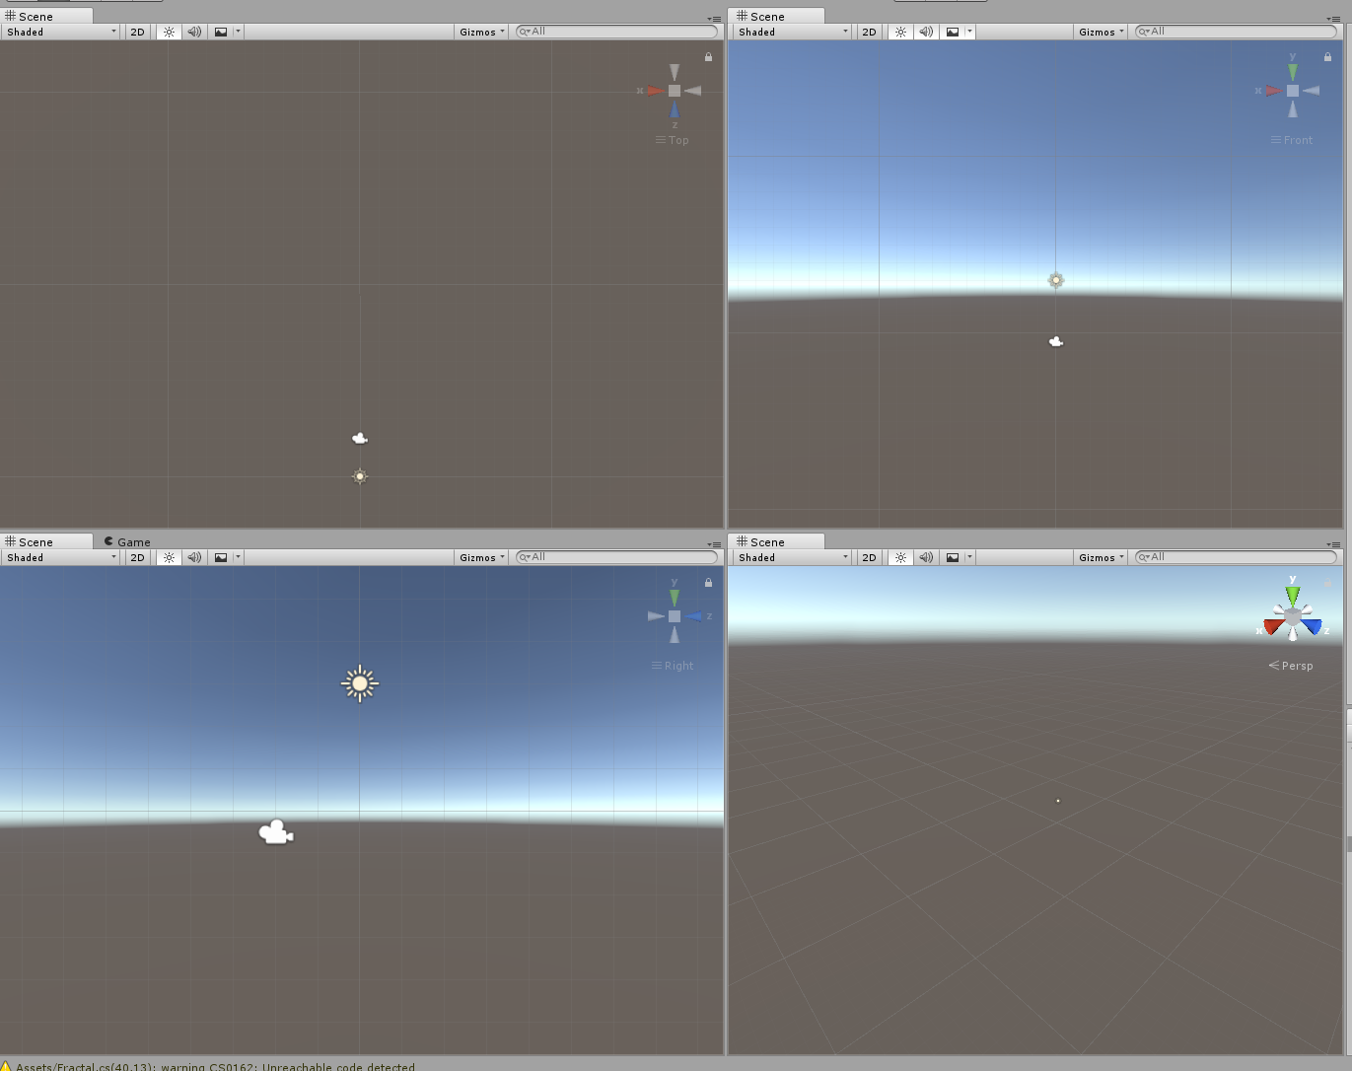
Milestone II – Graph Workflow

Slide 6
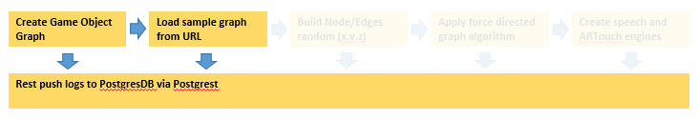
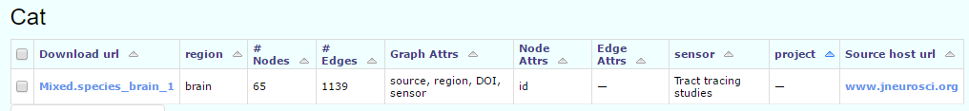
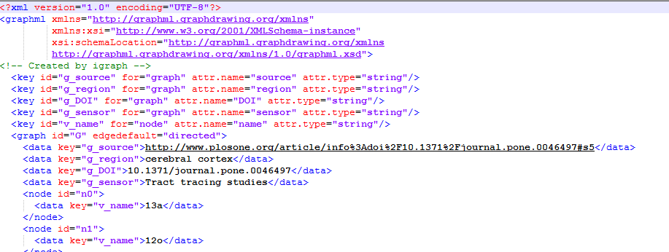
Milestone II – Graph Workflow
http://openconnecto.me/graph-services/download/

Slide 7
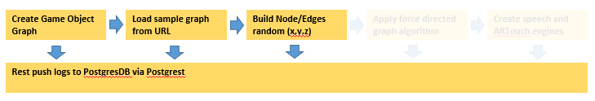
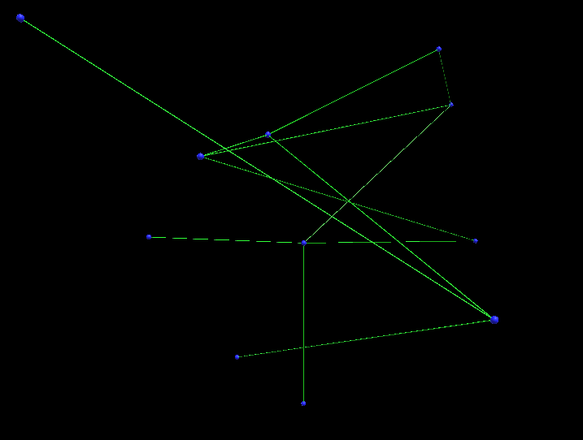
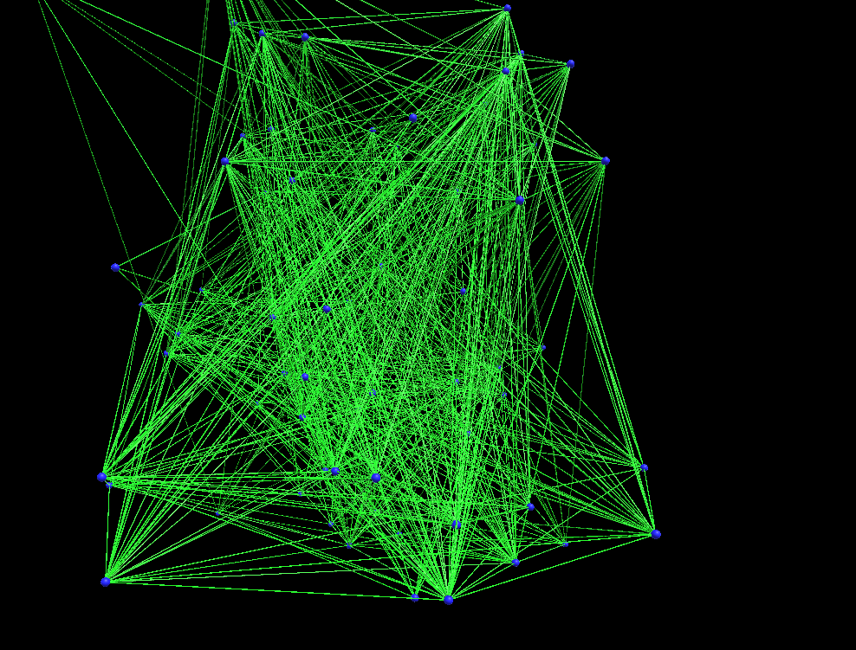
Milestone II – Graph Workflow

Slide 8
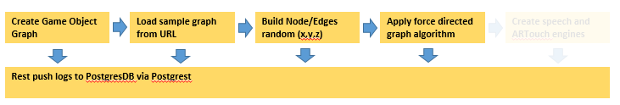
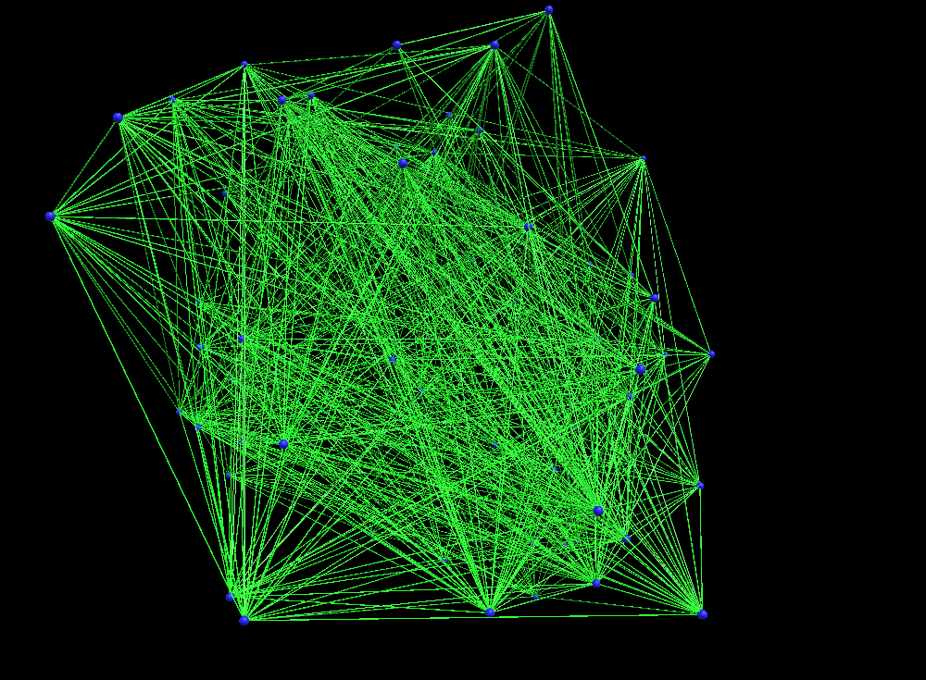
Milestone II – Graph Workflow

Slide 9
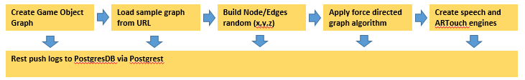
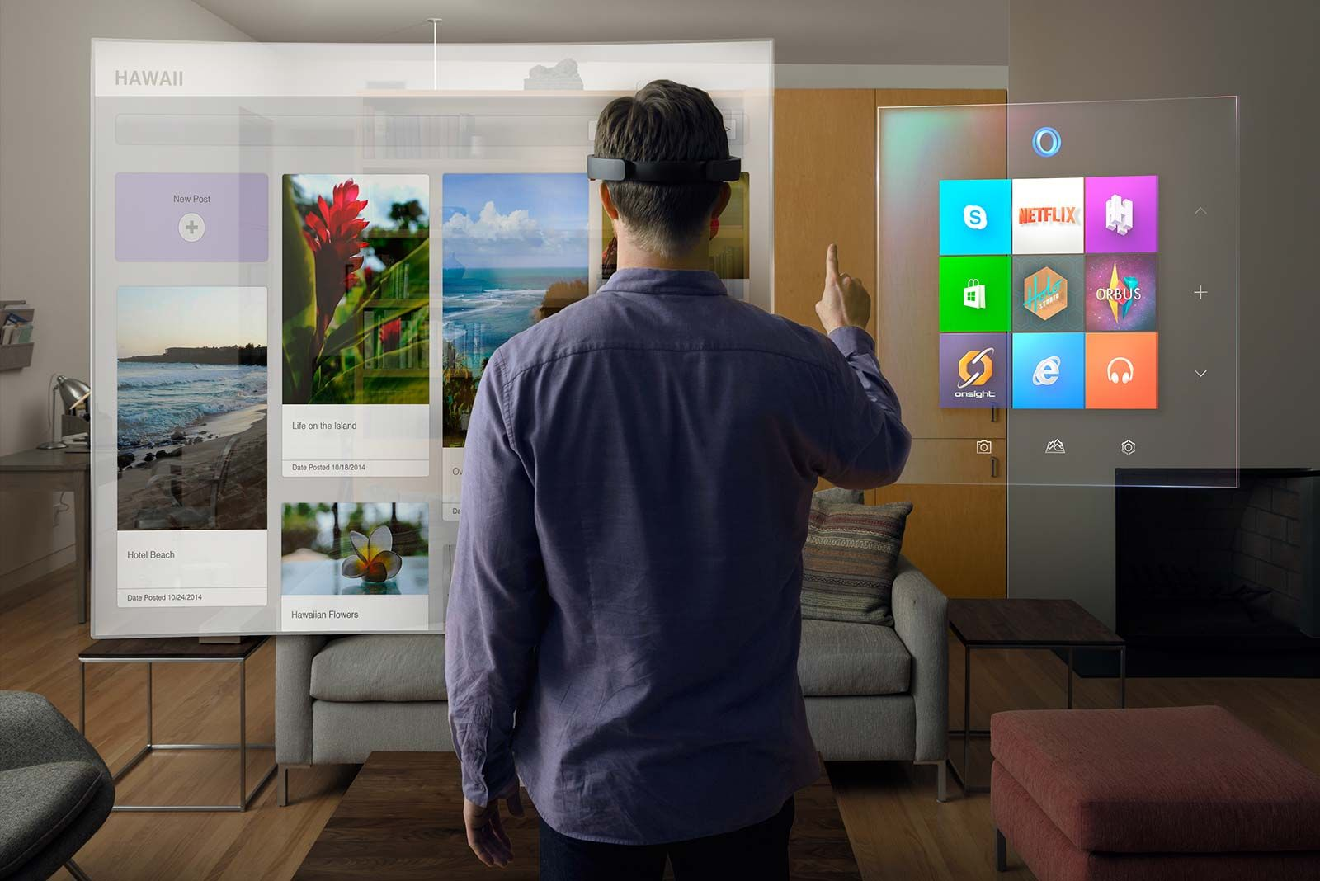
Milestone II – Graph Workflow
Milestone III

Slide 10
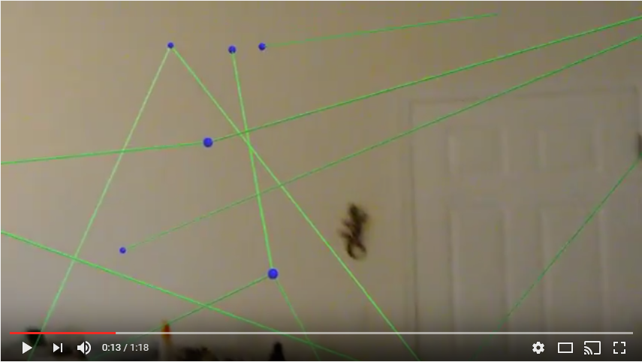
Milestone II – Demo

Slide 11
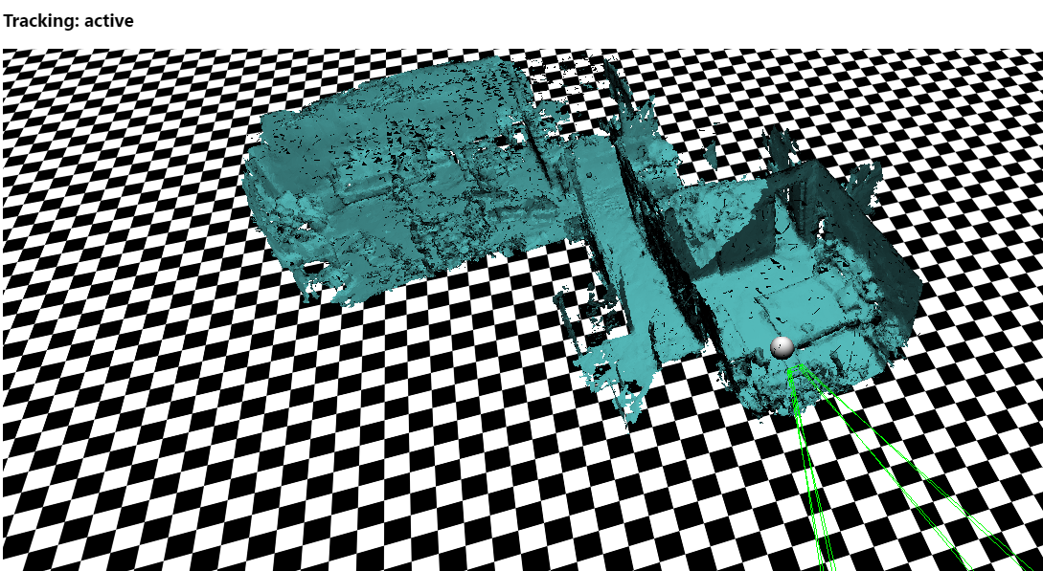
Milestone II – Misc Hololens Room Mapping

Slide 12
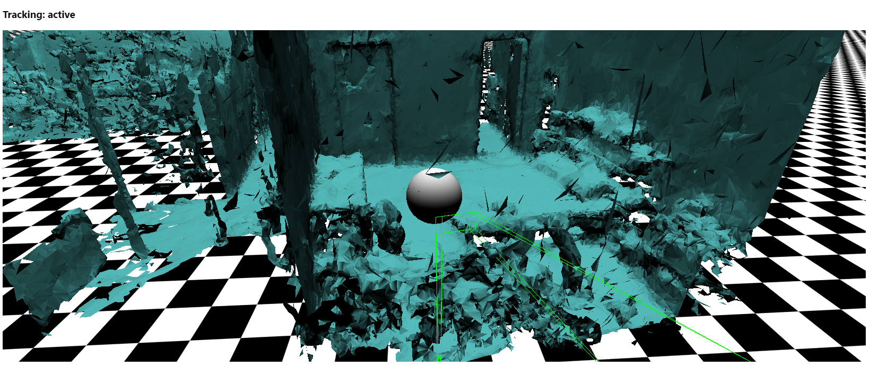
Milestone II – Misc. Hololens Room Mapping

Slide 13
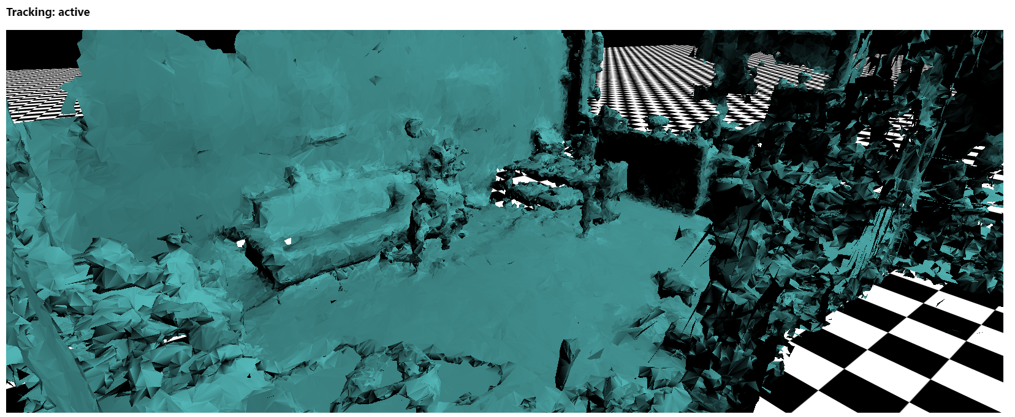
Milestone II – Misc. Hololens Room Mapping

Slide 14


Lessons Learned & Next Steps
Lessons Learned
Use only Core .NET & Unity Libraries:
Embedded Resource, File Transfer, Database(s) [Retrieving Graph]
Using Database Libraries Failed – NPGSQL, SQLite [storing debug logs]
For Unity Objects Do not call default constructors
this.gameObject.AddComponent<Graph>() vs new Graph()
Next Steps
Clean and tune current code:
Optimize graph layouts for room size
Review force directed graph algorithm
Graph interactions:
Voice commands to interact with the graph (e.g. find highly connected components visually)
Touch or Gesture to interact with the graph (e.g. touch a node to bring it into focus)
Provide Visual of graph properties:
Visualize node or edge properties
Connect to Graph DBs:
SystemG and Neo4j

Slide 15

Questions

